Slide 1
CHAPTER 4 POLYMORPHISM
Er. Ganga Gautam

Slide 2
OUTLINES
Introduction to Polymorphism
Types of Polymorphism: Compile Time Polymorphism: Function Overloading, Operator Overloading Runtime Polymorphism: Virtual Function
Overloading Unary and Binary Operators
Function Overriding
this Pointer and Object Pointer
Pure Virtual Function, Abstract Class
Virtual Destructor
Type Conversion: Basic to User-Defined, User-Defined to Basic, User-defined to User-Defined

Slide 3
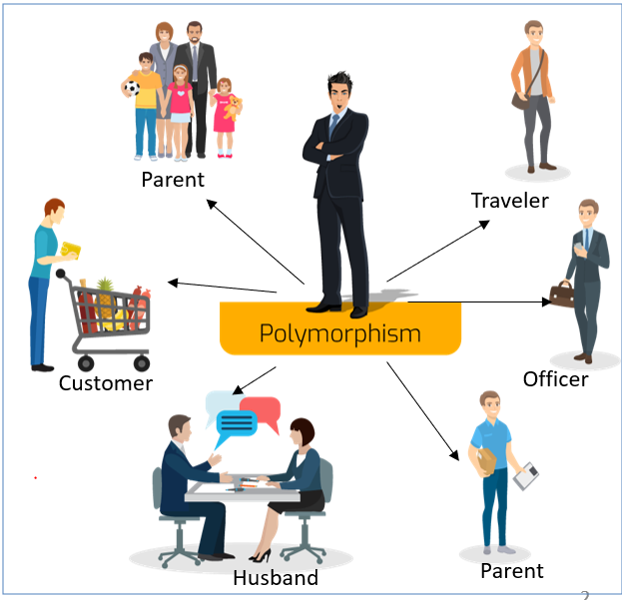
5.1 Polymorphism
Greek words: poly means many and morph means forms.
It simply means more than one form. That is, the same entity (function or operator) behaves differently in different scenarios.

Slide 4
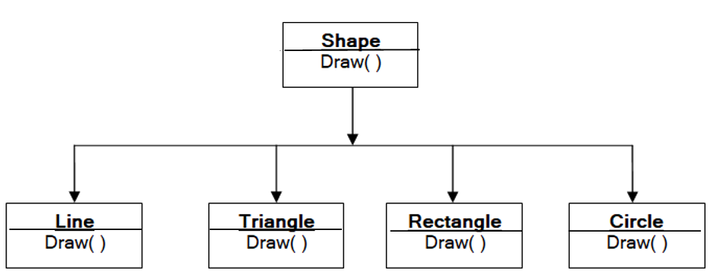
5.1 Polymorphism (contd.)
Polymorphism is an important concept of object-oriented programming.
The + operator in C++ is used to perform two specific functions.
When it is used with numbers (integers and floating-point numbers), it performs addition.
And when we use the + operator with strings, it performs string concatenation.
Polymorphism is the concept with the help of which single action in different ways can be performed.
In OOP, polymorphism refers to identically named function members that have different behavior depending on the type of object they have.
Basically, we can define it as the ability for derived classes to redefine methods.

Slide 5
Ways of implementing polymorphism:
Function overloading
Operator overloading
Function overriding
Virtual functions

Slide 6
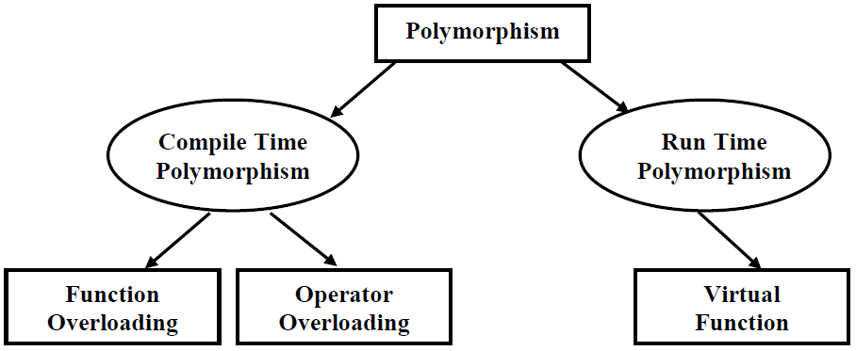
5.2. Types of polymorphism

Slide 7
5.2. Types of polymorphism (contd.)
1. Compile-Time Polymorphism:
Choosing member function in a normal way during compilation time is called Compile-time polymorphism.
implemented using the overloaded functions and operators.
The overloaded member functions are ‘selected’ for invoking by matching arguments, both type and number.
This information is known to the compiler at the compile time and, therefore compiler is able to select the appropriate function for a particular call at the compile time itself.
This is called early binding or static binding or static linking.
Early binding simply means that an object is bound to its function call at compile time.

Slide 8
5.2. Types of polymorphism
2. Run-Time Polymorphism:
Choosing member function during execution time is called Run-time polymorphism.
The compiler does not know about the correct form of the function to be called.
The correct form of the function is selected to call on the basis of content of calling object at run time.
Also called Late-binding or Dynamic Binding or Dynamic Linkage.
C++ supports a mechanism known as virtual function to achieve runtime polymorphism.

Slide 9
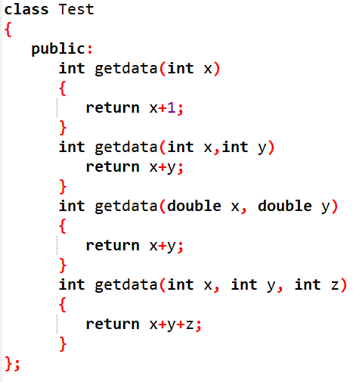
5.3 Function Overloading
Function Overloading is defined as the process of having two or more functions within a class having same name, but different in parameters.
Function overloading is done in two ways:
By changing number of arguments or parameter.
By changing the data type

Slide 10
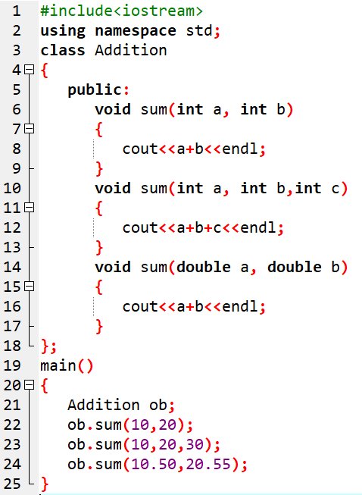
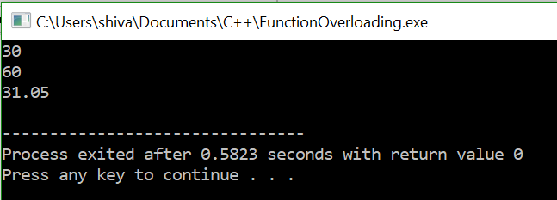
Function Overloading : Sample program

Slide 11
Operator Overloading
Operator overloading refers to the use of an operator for different purposes in different data types.
To add two integers, + operator is used.
However, for user-defined types (like objects), we can redefine the way operator works.
For example: If there are two objects of a class that contains string as its data members, we can redefine the meaning of + operator and use it to concatenate those strings.
The operator to be overloaded is defined using the operator keyword.
Below is the list of operators that are not overloaded:
Scope resolution operator | ::
Size of operator | sizeof
Dot operator | .
Pointer selector | *
Ternary operator | ?:

Slide 12
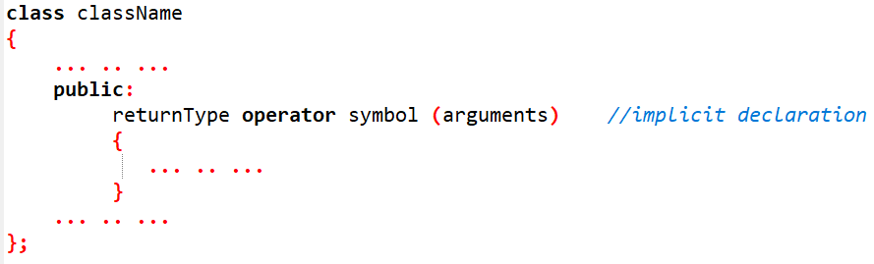
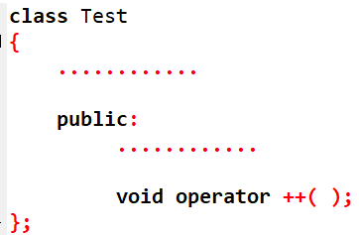
Operator Overloading (Contd.)
To overload an operator, a special operator function is defined inside the class (Implicit declaration) as:
Where;
returnType is the type of the data that is to be returned by the specified operator() function.
Operator is the function name for operator overloading.
symbol is the operator that is being overloaded (i.e. + , ++, etc)
arguments list receives the values.
Eg:

Slide 13
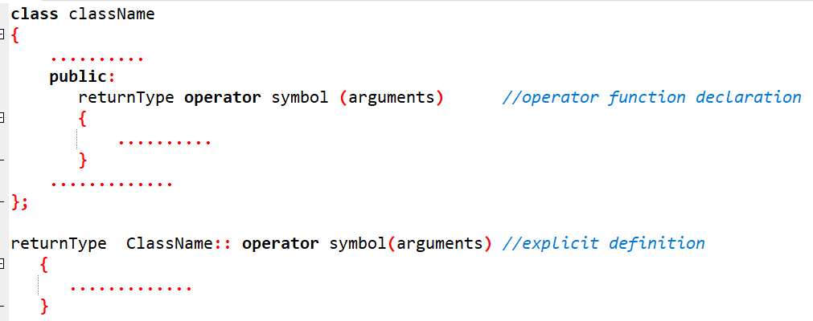
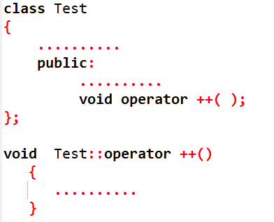
5.4 Operator Overloading (Contd.)
If defined outside the class (Explicit declaration), the general form is as:
Eg:

Slide 14
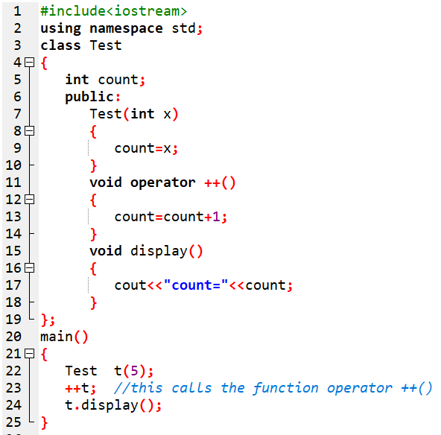
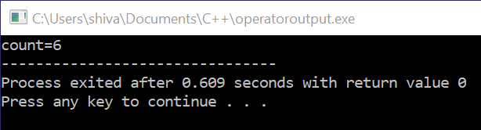
Sample program 1
This function is called when ++ operator operates on the object of Test class (object t in this case).
In the program, void operator ++ () operator function is defined (inside Test class).
This function increments the value of count by 1 for t object.

Slide 15
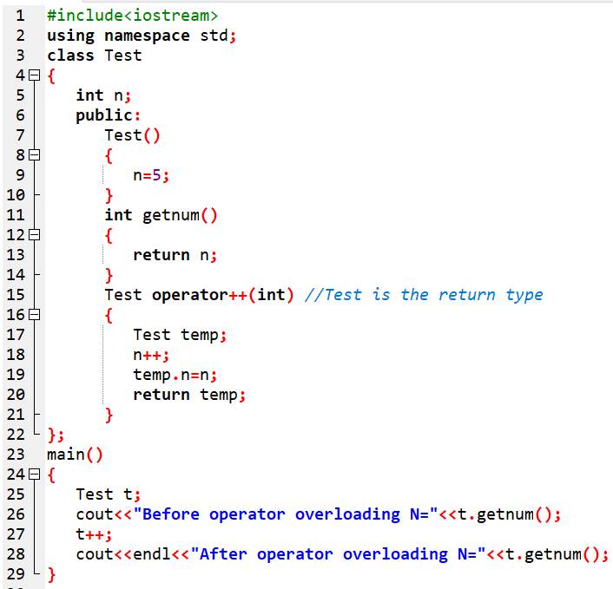
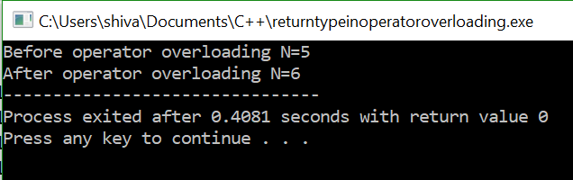
5.4.1 Operator arguments and ReturnType
Like any other functions, an overloaded operator has a return type and a parameter list.
Return Type:
The return type of operator function is always a class type,
because the operator overloading is only for objects.

Slide 16
5.4.1 Operator arguments
Operator function should be:
either member function or
a friend function.
An operator function, as a member function, requires:
one argument for binary operators and
no argument for unary operator.
When operator function (as member function) is called,
the calling object is passed implicitly to the function and hence available for member function.
An operator function, as a friend function, require:
two arguments for binary operators and
one argument for unary operator.
When operator function (as friend function) is called,
it is essential to pass the objects by value or reference.

Slide 17
5.4.2 Types of Operator overloading
Unary operator overloading
Binary operator overloading

Slide 18
i) Unary Operator overloading
The operator that requires only one operand to perform its operation are known as unary operators.
Examples of Unary operators:
unary minus (-),
unary plus (+),
increment (++),
decrement(--),
logical not (!), etc.
The operations in which unary operators are overloaded are known as Unary operator overloading.

Slide 19
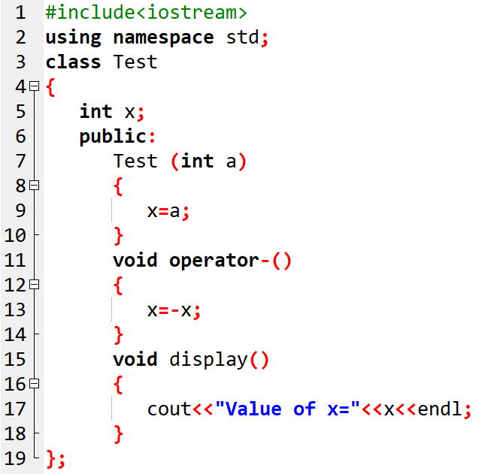
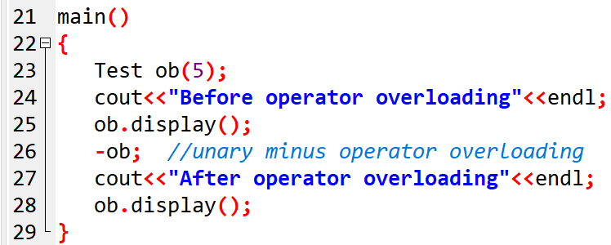
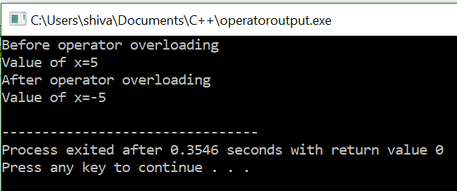
Sample program 1: WAP to overload unary minus (-).
In the above program, the minus (-) operator is overloaded.
This operator is used to make negative value of built-in datatype x, and
the same minus (-) operator is also applied to user-defined datatype ob which calls the function operator-().

Slide 20
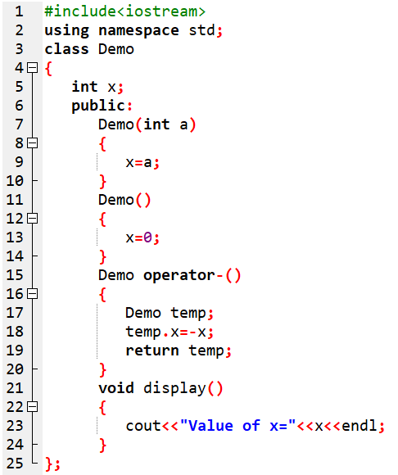
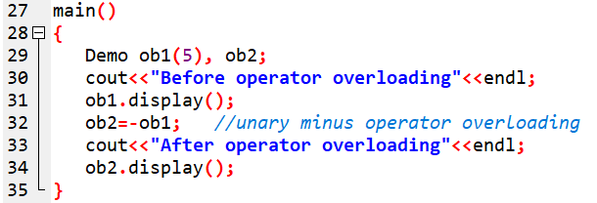
The same above program can be written as:

Slide 21
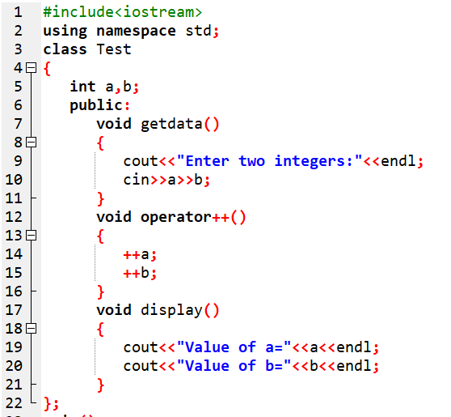
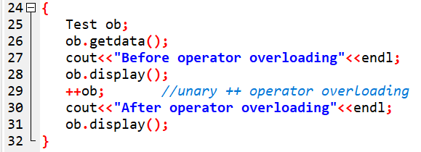
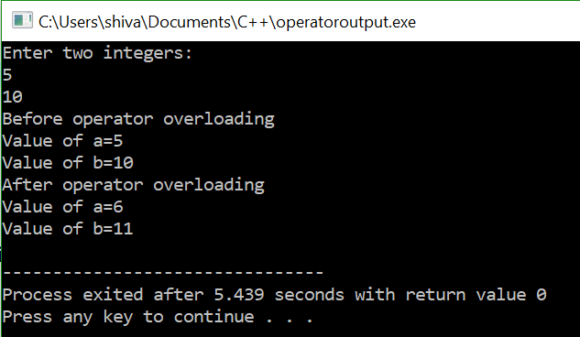
Sample program 2: WAP to overload increment operator (++) in prefix notation.

Slide 22
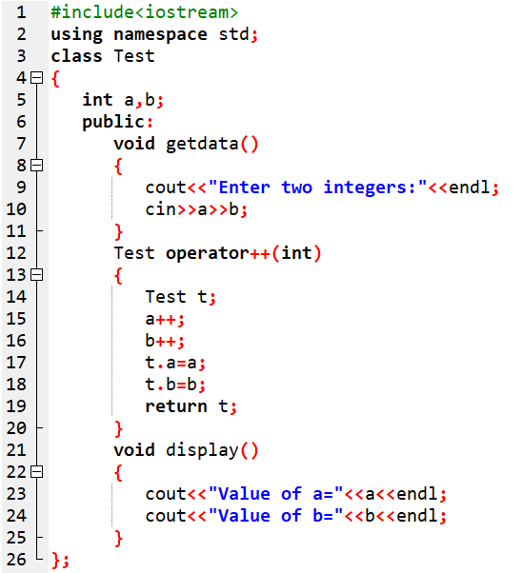
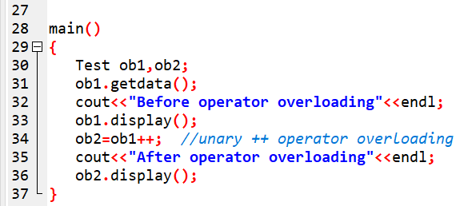
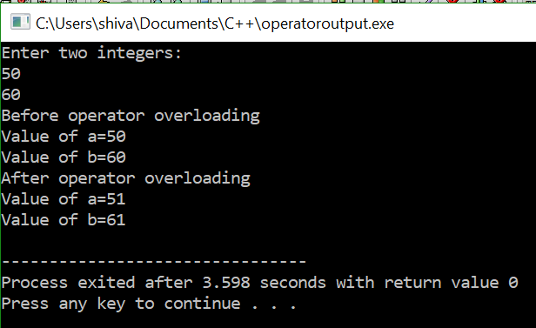
Sample program 3: WAP to overload increment operator (++) in postfix notation.

Slide 23
Practise:
WAP to overload decrement operator (--) in prefix notation.
WAP to overload decrement operator (--) in postfix notation.
WAP to input x and y coordinate and move 4 units from both x and y direction by overloading unary ++ operator in prefix notation.
WAP to input x and y coordinate and move 4 units from both x and y direction by overloading unary ++ operator in postfix notation.

Slide 24
ii) Binary Operator overloading
The operators which require two operand for its operations are known as binary operators.
Examples of binary operators :
binary plus(+),
binary minus(-),
greater than(>), equal to (==) , etc.
The operations in which the binary operators are overloaded are known as binary operator overloading.

Slide 25
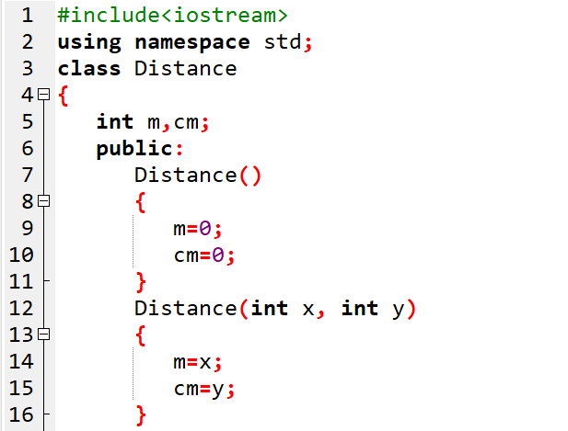
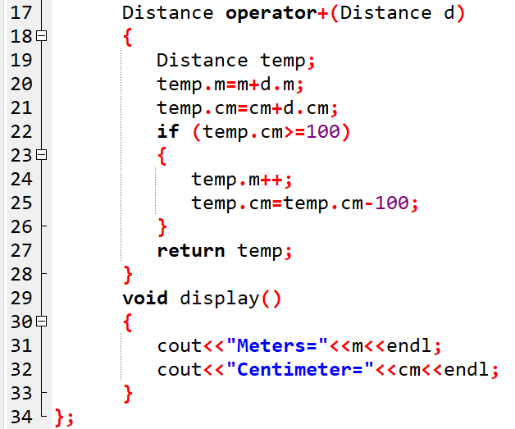
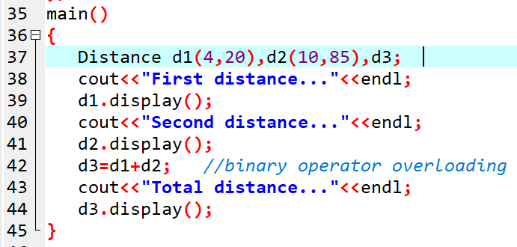
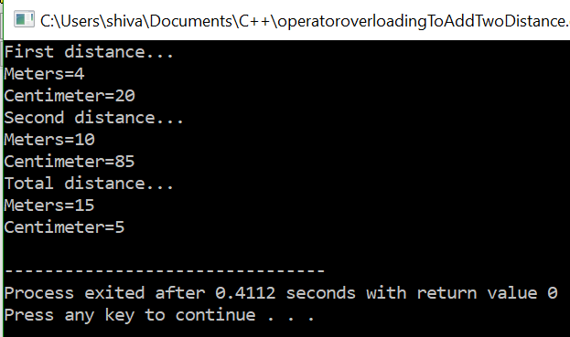
Sample program 1 :
WAP to overload binary plus (+) operator for addition of two distances expressed in m and cm.

Slide 26
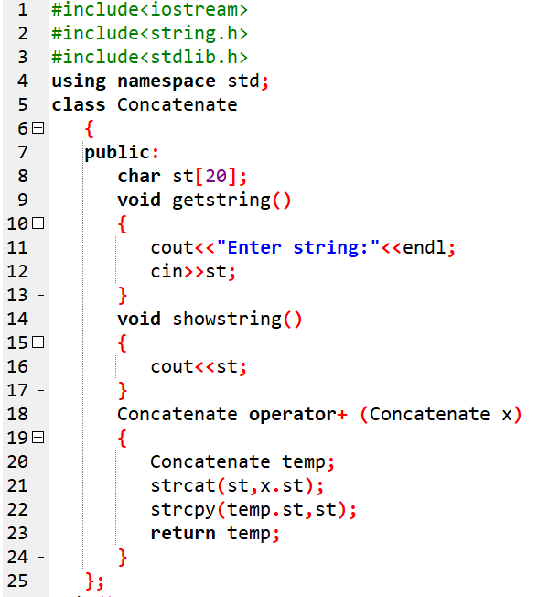
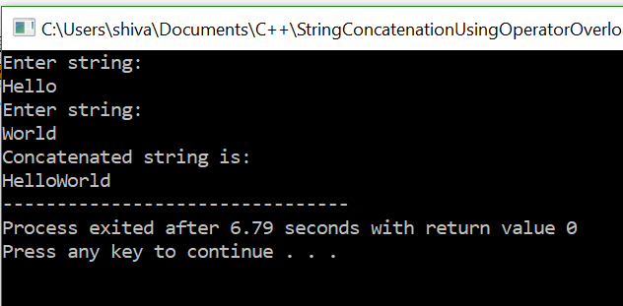
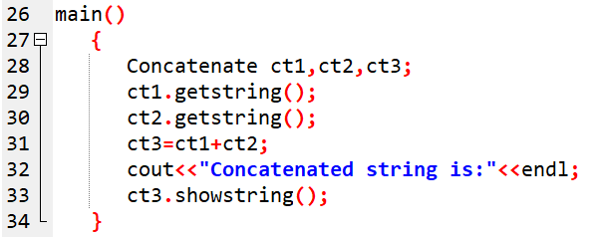
Sample program 2 :
WAP to overload binary plus (+) operator for concatenation of two input strings.

Slide 27
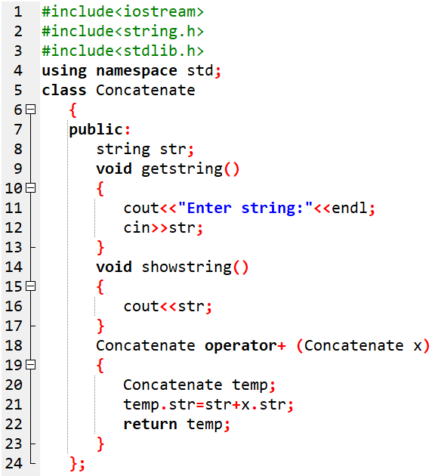
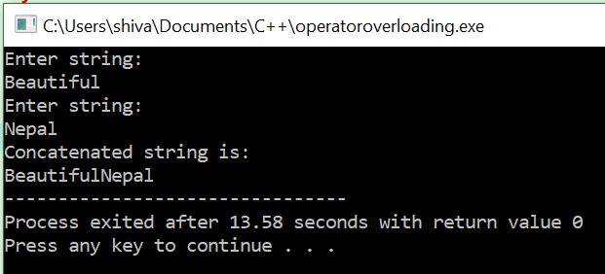
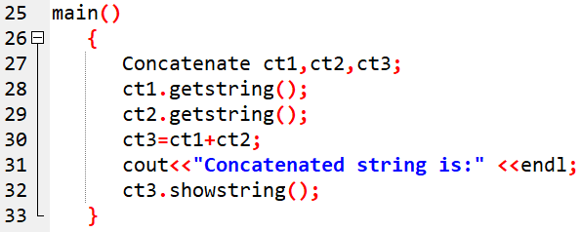
The above program can also be coded as:

Slide 28
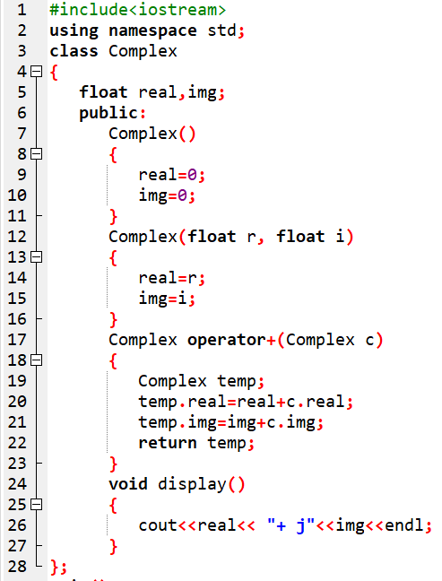
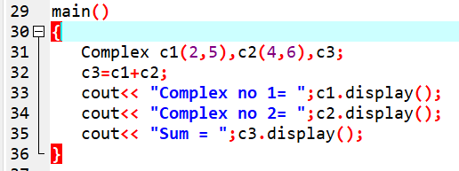
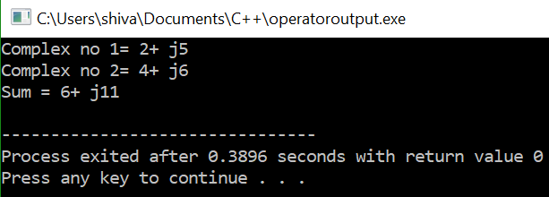
Sample program 3 :
WAP to overload binary plus (+) operator for addition of two complex numbers.

Slide 29
Practise:
WAP to overload less than relational operator (<)
WAP to overload equality operator (==)
WAP to enter two amount of money in terms of rupees and paisa and then add them using binary plus (+) operator overloading.

Slide 30
5.4.3 Operator Overloading using Friend function
Friend function can be used as operator function in place of member function for overloading of operators.
The only difference is that a friend function require:
only one argument for unary operators and
two arguments for binary operators
to be explicitly passed to it.
As the friend function is non-member function of a class, it is called without object.
Therefore, there is no calling object and all objects are passed in operator function via arguments.

Slide 31
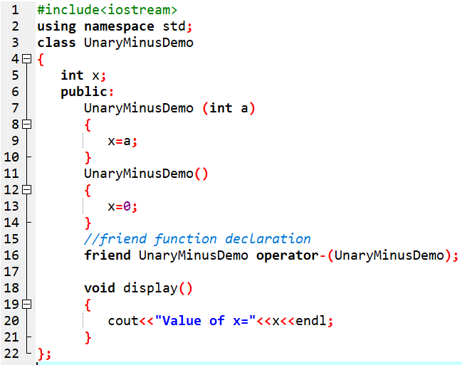
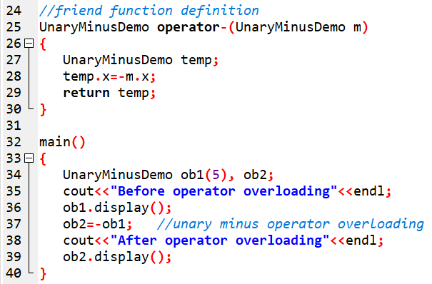
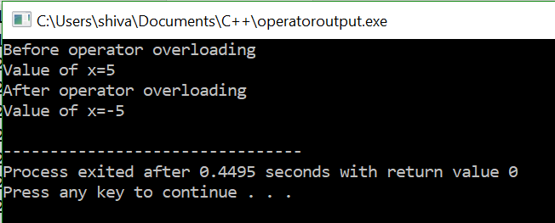
Sample program :
WAP to overload unary minus (-) operator using friend function.
For other sample programs:
Please refer:
A textbook of Object Oriented Programming in C++, Ram Datta Bhatta, pp159-166

Slide 32
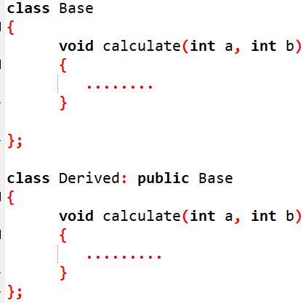
5.5 Function Overriding
Function overriding is the use of two or more functions having same name and argument types, but defined one in the base class and other in derived class.
The instance of base class is replaced (or overridden) by the instance of child class.
Function overriding cannot be done within a class.
However, when a function with same name and signature is defined in base class and derived class, ambiguity occurs.
Such ambiguity is resolved in two ways:
Using scope resolution operator
Using virtual function.

Slide 33
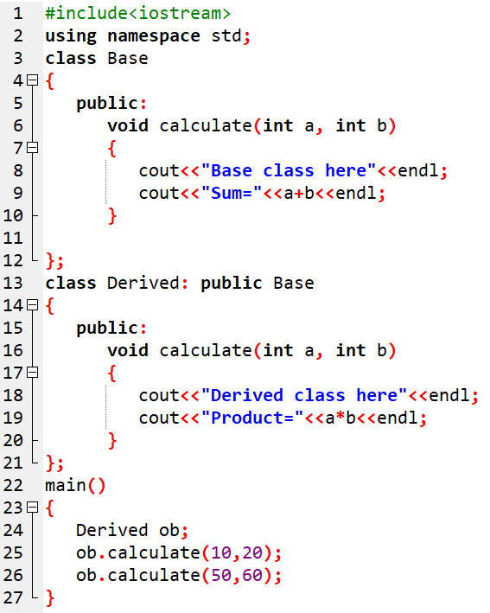
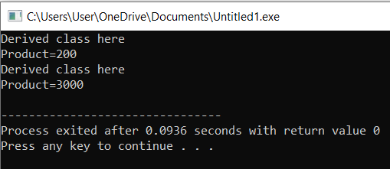
5.5 Function Overriding : Sample program

Slide 34
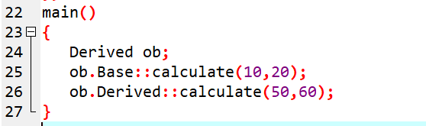
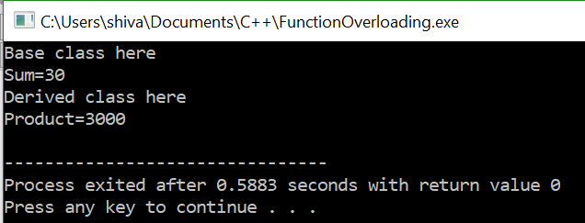
5.5 Function Overriding : Resolved

Slide 35
5.6 Virtual Function overriding
A Virtual function is a member function declared in a base class with keyword virtual and referenced by derived class.
Virtual means existing in effect but not in reality.
Once a function is declared virtual, it remains virtual all the way down the inheritance hierarchy.
For accessing the derived class function members, the base class pointers are used to point derived class objects.

Slide 36
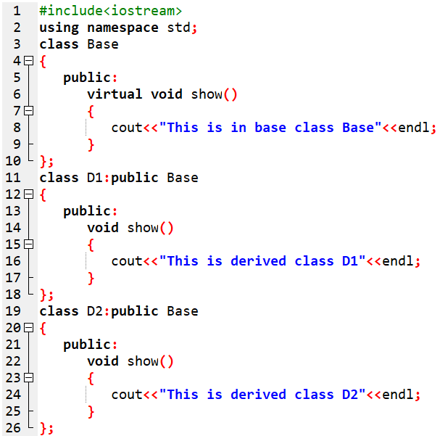
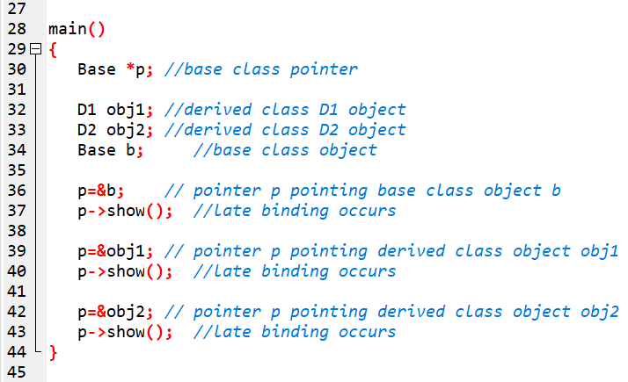
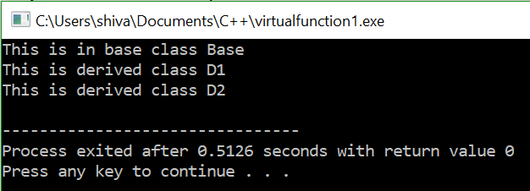
5.6 Virtual Function overriding : Sample program

Slide 37
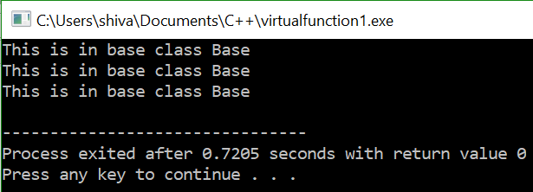
5.6 Virtual Function overriding : Sample program
In the above example, if the function show() in the Base class was not defined as virtual, then the Base class pointer (*b) would always call the base class version of show() and the output would be:
This was because the C++ compiler ignores the content of b (which is address of obj1 after statement p=&obj1; ) and execute the function which is inherited from class Base because the type b matches with class Base.
Similarly, after statement p=&obj2; and p->show(); , the compiler again executes the function which is inherited from class Base.
Whenever this type of situation occurs (i.e.in derived class, there are two functions, both have the same name: one inherited from base and another of its own, and the pointer is Base type), then we want to execute the function through pointer, compiler chooses the function of Base class. So, to overcome this situation, we have to make the base class function as virtual.
Thus the use of same function call at different places produces different result at run time. Hence, it provides the concept of polymorphism.

Slide 38




WAP to create a class Figure with dim1 and dim2 as data members and constructor to initialize its data. Create a derived class called Triangle and define a member function area() in it to calculate the area of triangle. Create another derived class Rectangle and define a member function area() to calculate the area of rectangle. Implement this program using the concept of runtime polymorphism.

Slide 39
5.7 Pure Polymorphism
A pure virtual function is a virtual function in the base class and has no body with it.
They are just declared inside the base class and redefined in derived class.
Pure virtual functions are also called “Do nothing” functions.
In such cases, the compiler requires each derived class to either define the function or redeclare it as a pure virtual function.
Pure virtual function cannot be used to declare any object of its own.
The main objective of abstract base class (ABC) is to provide some facilities to the derived class and to create a base pointer required for achieving runtime polymorphism.
General syntax for do-nothing function is:
virtual Return-type function-name()=0;
Eg:
virtual void show()=0;

Slide 40


5.7 Pure Polymorphism: Sample program

Slide 41



5.7 Pure Polymorphism: Sample program

Slide 42


5.7 Pure Polymorphism: Sample program

Slide 43
5.8 Type conversion
If an expression contains different types of data like integer and float in left and right hand side, then the compiler automatically converts from one type to another type by applying type conversion rule provided by the compiler.
The automatic type conversion means that the right side of the data is automatically converted to the left side type.
This type of conversion rules cannot be applied in case of user-defined datatypes.
In user-defined datatypes, we must define conversion routines ourselves.
The possible types are:
Conversion from basic type to another basic type
Conversion from basic type to class type
Conversion from class type to basic type
Conversion from one class type to another class type

Slide 44
1. Basic type to Another Basic type
Dataypes like int, float, double, long, long double, char etc are basic datatypes.
We can convert one basic data type into another.
There are two types of conversion: implicit and explicit.

Slide 45




1. Basic type to Another Basic type
Implicit conversion:
It is also known as automatic conversion, or promotion or widening.
This does not require any operator and is performed by compiler itself.
Eg:
Explicit conversion:
This is also known as Type casting.
The conversion of one datatype into another datatype is performed by programmer as per the need.
Eg:

Slide 46

2. Basic type to Class type
The conversion from basic to user defined data types (class type) can be done using :
constructors with one argument of basic type.
General form:

Slide 47



2. Basic type to Class type : Sample program
WAP to convert temperature in Fahrenheit into Celsius using type conversion from basic type to class type.

Slide 48

3. Class type to Basic type
Conversion from Class type(user-defined type) to basic data type is done by overloading the casting operator of basic type as a member function.
Operator function is defined as an overloaded basic data type which takes no arguments.
Return type of operator is not specified because the casting operator function itself specifies the return type.
The casting operator function should satisfy the following condition:
It must be a class member.
It must not specify any return type.
It must not have any arguments.
Syntax

Slide 49



3. Class type to Basic type : Sample program

Slide 50
4. One ClassType to another ClassType
The conversion form object of one class to object of another class can be performed using:
either one-argument constructor, or
a conversion function.
The choice depends upon whether the conversion routine is declared in:
the source class, or
the destination class.

Slide 51

a) Routine in Source Object
When the conversion routine is in the source class, it is performed using a conversion function.
The syntax of conversion function will be:

Slide 52




a) Routine in Source Object: Sample program
Define two classes Rectangular and Polar to represent the point in polar and rectangular form and use conversion routine to convert from one form to another(i.e convert object of class Polar into object of class Rectangular).

Slide 53

a) Routine in Source Object: Sample program
Here, in the above program, the data members in the Polar class is float type (i.e. Polar type).
This is converted into Rectangular type (i.e. int type).
If we had declared as int xr, yr; in the class Rectangular, our output would be.

Slide 54
b) Routine in Destination Object
When the conversion routine is in the destination class, we use a one-argument constructor.

Slide 55



b) Routine in Destination Object: Sample program
main( )

Slide 56
b) Routine in Destination Object: Sample program
Here, in the above program, the data members in the Polar class is float type (i.e. Polar type).
This is converted into Rectangular type (i.e. int type).
If we had declared as float xr, yr; in the class Rectangular, our output would be.

Slide 57
5.9 This pointer
The member function of every object have access to a pointer named this, which point to the object itself.
When we call a member function, it comes into existence with the value of this set to the address of the object for which it was called.
The this pointer can be treated like any other pointer to an object.
Characteristics of this pointer:
this pointer stores the address of invoking object of the class.
this pointers are not accessible for static member functions.
this pointers are not modifiable.
Uses of this pointer:
To specify memory address of an object.
To access data members.

Slide 58


5.9 This pointer : Sample program

Slide 59
5.10 Object Pointer
Just like other pointers, the object pointer are declared by placing in front of an object’s name.
General syntax is :
Class_name * ObjectPointerName;
Eg:
Demo * p;
The object pointer should reference the object to which it has to point.
Eg:
p=&ob;
When accessing members of a class using an object pointer the Arrow Operator ( -> ) is used instead of the Dot ( . ) operator.
Eg:
p-> showdata();

Slide 60


5.10 Object Pointer : Sample program

Slide 61
5.11 Polymorphic variable
Polymorphic variables are variables that can refer to a variety of objects of different type during the execution of a program.
The types to which a polymorphic variable refers are not necessarily the type of the polymorphic variable itself.
It has two types:
Static type
Dynamic type

Slide 62


a) Static Type
The type used in the declaration of a polymorphic variable is called the static type.
In C++, a polymorphic variable is declared in several ways, including:
i) As a pointer to an object of related type,
Eg:
Here p is a polymorphic variable.
ii) As a by-reference parameter to an object of related type.
Eg:
Here ob is a polymorphic variable.

Slide 63

b) Dynamic Type
The type of the object referred by a polymorphic variable is called dynamic type.
The dynamic type need not to be the same as the static type.
The dynamic type may depend upon the execution path through the program.
Eg:
Here ob is a polymorphic variable.

Slide 64
End of Chapter 4

